Slide 1
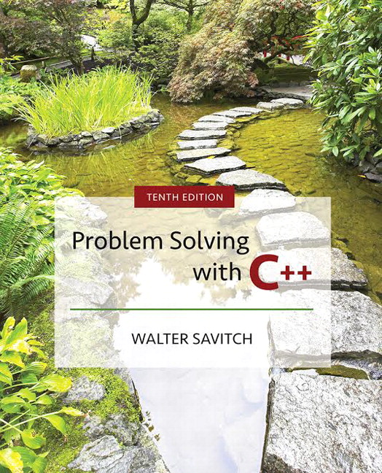

Slide 2
Chapter 12
Separate Compilation
and
Namespaces

Slide 3
Overview
12.1 Separate Compilation
12.2 Namespaces
Slide 12- <number>

Slide 4
12.1
Separate Compilation

Slide 5
Separate Compilation
C++ allows you to divide a program into parts
  Each part can be stored in a separate file
  Each part can be compiled separately
  A class definition can be stored separately from a
  program.
    This allows you to use the class in multiple programs
Slide 12- <number>

Slide 6
ADT Review
An ADT is a class defined to separate the
interface and the implementation
  All member variables are private
  The class definition along with the function and
  operator declarations are grouped together as the
  interface of the ADT
  Group the implementation of the operations together
  and make them unavailable to the programmer
  using the ADT
Slide 12- <number>

Slide 7
The ADT Interface
The interface of the ADT includes
  The class definition
  The declarations of the basic operations which can be one of the following
    Public member functions
    Friend functions
    Ordinary functions
    Overloaded operators
  The function comments
Slide 12- <number>

Slide 8
The ADT Implementation
The implementation of the ADT includes
  The function definitions
    The public member functions
    The private member functions
    Non-member functions
    Private helper functions
  Overloaded operator definitions
  Member variables
  Other items required by the definitions
Slide 12- <number>

Slide 9
Separate Files
In C++ the ADT interface and implementation
can be stored in separate files
  The interface file stores the ADT interface
  The implementation file stores the ADT
  implementation
Slide 12- <number>

Slide 10
A Minor Compromise
The public part of the class definition is part of
the ADT interface
The private part of the class definition is part of
the ADT implementation
  This would hide it from those using the ADT
C++ does not allow splitting the public and
private parts of the class definition across files
  The entire class definition is usually in the
  interface file
Slide 12- <number>

Slide 11
Case Study: DigitalTime
The interface file of the DigitalTime ADT class
contains the class definition
  The values of the class are:
    Time of day, such as 9:30, in 24 hour notation
  The public members are part of the interface
  The private members are part of the implementation
  The comments in the file should provide all the
  details needed to use the ADT
Slide 12- <number>

Slide 12
Naming The Interface File
The DigitalTime ADT interface is stored in a
file named dtime.h
  The .h suffix means this is a header file
  Interface files are always header files
A program using dtime.h must include it using
an include directive
#include "dtime.h"
Display 12.1
Slide 12- <number>

Slide 13
#include " " or < > ?
To include a predefined header file use < and >
#include <iostream>
  < and > tells the compiler to look where the system
  stores predefined header files
To include a header file you wrote, use " and "
#include "dtime.h"
  " and " usually cause the compiler to look
  in the current directory for the header file
Slide 12- <number>

Slide 14
The Implementation File
Contains the definitions of the ADT functions
Usually has the same name as the header file but
a different suffix
    Since our header file is named dtime.h, the
    implementation file is named dtime.cpp
    Suffix depends on your system
    (some use .cxx or .CPP)
Slide 12- <number>

Slide 15
#include "dtime.h"
The implementation file requires an include
directive to include the interface file:
#include "dtime.h"
Display 12.2 (1)
Display 12.2 (2)
Display 12.2 (3)
Slide 12- <number>

Slide 16
The Application File
The Application file is the file that contains the
program that uses the ADT
  It is also called a driver file
  Must use an include directive to include the
  interface file:
  #include "dtime.h"
Display 12.3
Slide 12- <number>

Slide 17
Running The Program
Basic steps required to run a program:
(Details vary from system to system!)
  Compile the implementation file
  Compile the application file
  Link the files to create an executable program using a utility called a linker
    Linking is often done automatically
Slide 12- <number>

Slide 18
Compile dtime.h ?
The interface file is not compiled separately
  The preprocessor replaces any occurrence of
  #include "dtime.h" with the text of dtime.h before compiling
  Both the implementation file and the
  application file contain #include "dtime.h"
    The text of dtime.h is seen by the compiler in each of these files
    There is no need to compile dtime.h separately
Slide 12- <number>

Slide 19
Why Three Files?
Using separate files permits
  The ADT to be used in other programs without
  rewriting the definition of the class for each
  Implementation file to be compiled once even
  if multiple programs use the ADT
  Changing the implementation file does not
  require changing the program using the ADT
Slide 12- <number>

Slide 20
Reusable Components
An ADT coded in separate files can be used
over and over
The reusability of such an ADT class
  Saves effort since it does not need to be
    Redesigned
    Recoded
    Retested
  Is likely to result in more reliable components
Slide 12- <number>

Slide 21
Multiple Classes
A program may use several classes
  Each could be stored in its own interface and
  implementation files
    Some files can "include" other files, that include still others
  It is possible that the same interface file could be
  included in multiple files
  C++ does not allow multiple declarations of a class
  The #ifndef directive can be used to prevent
  multiple declarations of a class
Slide 12- <number>

Slide 22
Introduction to #ifndef
To prevent multiple declarations of a class,
we can use these directives:
  #define DTIME_H
  adds DTIME_H to a list indicating DTIME_H has been seen
  #ifndef DTIME_H
  checks to see if DTIME_H has been defined
  #endif
  If DTIME_H has been defined, skip to #endif
Slide 12- <number>

Slide 23
Using #ifndef
Consider this code in the interface file
#ifndef DTIME_H
#define DTIME_H
< The DigitalTime class
definition goes here>
#endif
  The first time a #include "dtime.h" is found,
  DTIME_H and the class are defined
  The next time a #include "dtime.h" is found,
  all lines between #ifndef and #endif are skipped
true
false
Slide 12- <number>

Slide 24
Why DTIME_H?
DTIME_H is the normal convention for
creating an identifier to use with ifndef
  It is the file name in all caps
  Use ' _ ' instead of ' . '
You may use any other identifier, but will make
your code more difficult to read
Display 12.4
Slide 12- <number>

Slide 25
Defining Libraries
You can create your own libraries of functions
  You do not have to define a class to use separate
  files
  If you have a collection of functions…
    Declare them in a header file with their comments
    Define them in an implementation file
    Use the library files just as you use your class interface
    and implementation files
Slide 12- <number>

Slide 26
Section 12.1 Conclusion
Can you
  Determine which belongs to the interface,
  implementation or application files?
    Class definition
    Declaration of a non-member function used as an
    operation of the ADT
    Definition of a member function
    The main part of the program
  Describe the difference between a C++ class and an ADT?
Slide 12- <number>

Slide 27
12.2
Namespaces

Slide 28
Namespaces
A namespace is a collection of name definitions,
such as class definitions and variable declarations
  If a program uses classes and functions written by
  different programmers, it may be that the same name
  is used for different things
  Namespaces help us deal with this problem
Slide 12- <number>

Slide 29
The Using Directive
#include <iostream> places names such as cin
and cout in the std namespace
The program does not know about names in the
std namespace until you add
using namespace std;
(if you do not use the std namespace, you can
define cin and cout to behave differently)
Slide 12- <number>

Slide 30
The Global Namespace
Code you write is in a namespace
  it is in the global namespace unless you specify a namespace
  The global namespace does not require the
  using directive
Slide 12- <number>

Slide 31
Name Conflicts
If the same name is used in two namespaces
  The namespaces cannot be used at the same time
  Example: If myFunction is defined in
  namespaces ns1 and ns2, the two versions of
  myFunction could be used in one program
  by using local using directives this way:
{
using namespace ns1;
myFunction( );
}
{
using namespace ns2;
myFunction( );
}
Slide 12- <number>

Slide 32
Scope Rules For using
A block is a list of statements enclosed in { }s
The scope of a using directive is the block in
which it appears
A using directive placed at the beginning of a
file, outside any block, applies to the entire file
Slide 12- <number>

Slide 33
Creating a Namespace
To place code in a namespace
  Use a namespace grouping
    namespace Name_Space_Name
    {
    Some_Code
    }
To use the namespace created
  Use the appropriate using directive
    using namespace Name_Space_Name;
Slide 12- <number>

Slide 34
Namespaces:
Declaring a Function
To add a function to a namespace
  Declare the function in a namespace grouping
  namespace savitch1
  {
  void greeting( );
  }
Slide 12- <number>

Slide 35
Namespaces:
Defining a Function
To define a function declared in a namespace
  Define the function in a namespace grouping
  namespace savitch1
  {
  void greeting( )
  {
  cout << "Hello from namespace savitch1.\n";
  }
  }
Slide 12- <number>

Slide 36
Namespaces:
Using a Function
To use a function defined in a namespace
  Include the using directive in the program where the namespace is to be used
  Call the function as the function would normally
  be called
  int main( )
  {
  {
  using namespace savitch1;
  greeting( );
  }
Display 12.5 (1-2)
Using directive's scope
Slide 12- <number>

Slide 37
A Namespace Problem
Suppose you have the namespaces below:
Is there an easier way to use both namespaces
considering that myFunction is in both?
namespace ns1
{
fun1( );
myFunction( );
}
namespace ns2
{
fun2( );
myFunction( );
}
Slide 12- <number>

Slide 38
Qualifying Names
Using declarations (not directives) allow us to
select individual functions to use from
namespaces
  using ns1::fun1; //makes only fun1 in ns1 avail
    The scope resolution operator identifies a namespace here
    Means we are using only namespace ns1's version of fun1
  If you only want to use the function once, call it
  like this
  ns1::fun1( );
Slide 12- <number>

Slide 39
Qualifiying Parameter Names
To qualify the type of a parameter with a
using declaration
  Use the namespace and the type name
  int getNumber (std::istream inputStream)
  …
    istream is the istream defined in namespace std
    If istream is the only name needed from namespace std, then you do not need to use
    using namespace std;
Slide 12- <number>

Slide 40
Directive/Declaration (Optional)
A using declaration (using std::cout;) makes
only one name available from the namespace
A using directive makes all the names in the
namespace available
Slide 12- <number>

Slide 41
A Subtle Point (Optional)
A using directive potentially introduces a name
If ns1 and ns2 both define myFunction,
using namespace ns1;
using namespace ns2;
is OK, provided myFunction is never used!
Slide 12- <number>

Slide 42
A Subtle Point Continued
A using declaration introduces a name into your code: no other use of the name can be made
  using ns1::myFunction;
  using ns2::myFunction;
  is illegal, even if myFunction is never used
Slide 12- <number>

Slide 43
Unnamed Namespaces
As we have done helper functions so far, they
are not really hidden (Display 12.2)
  We would like them to be local to the implementation
  file to implement information hiding
The unnamed namespace can hide helper
functions
  Names defined in the unnamed namespace are
  local to the compilation unit
    A compilation unit is a file (such as an implementation file)
    plus any file(s) #included in the file
Slide 12- <number>

Slide 44
The unnamed grouping
Every compilation unit has an unnamed
namespace
  The namespace grouping is written as any other namespace, but no name is given:
  namespace
  {
  void sample_function( )
  …
  } //unnamed namespace
Slide 12- <number>

Slide 45
Names In The unnamed namespace
Names in the unnamed namespace
  Can be reused outside the compilation unit
  Can be used in the compilation unit
  without a namespace qualifier
The rewritten version of the DigitalTime
interface is found in while the
implementation file is shown in
Display 12.6
Display 12.7 (1)
Display 12.7 (2)
Slide 12- <number>

Slide 46
Namespaces
In An Application
The application file for the DigitalTime ADT is
shown in
Display 12.8 (1)
Display 12.8 (2)
Slide 12- <number>

Slide 47
Compilation Units Overlap
A header file is #included in two files
  It is in two compilation units
  Participates in two unnamed namespaces!
  This is OK as long as each of the compilation
  units makes sense independent of the other
    A name in the header file's unnamed namespace
    cannot be defined again in the unnamed namespace of the implementation or application file
Slide 12- <number>

Slide 48
Naming Namespaces
To avoid choosing a name for a namespace that
has already been used
  Add your last name to the name of the namespace
  Or, use some other unique string
Slide 12- <number>

Slide 49
Global or unnamed?
Names in the global namespace have global
scope (all files)
  They are available without a qualifier to all the
  program files
Names in the unnamed namespace are local to
a compilation unit
  They are available without a qualifier within the
  compilation unit
Slide 12- <number>

Slide 50
Section 12.2 Conclusion
Can you
  Explain the purpose of using interface and
  implementation files?
  Describe a namespace?
  Demonstrate three ways to use the names in a
  namespace?
Slide 12- <number>

Slide 51
Chapter 12 -- End
Slide 12- <number>

Slide 52
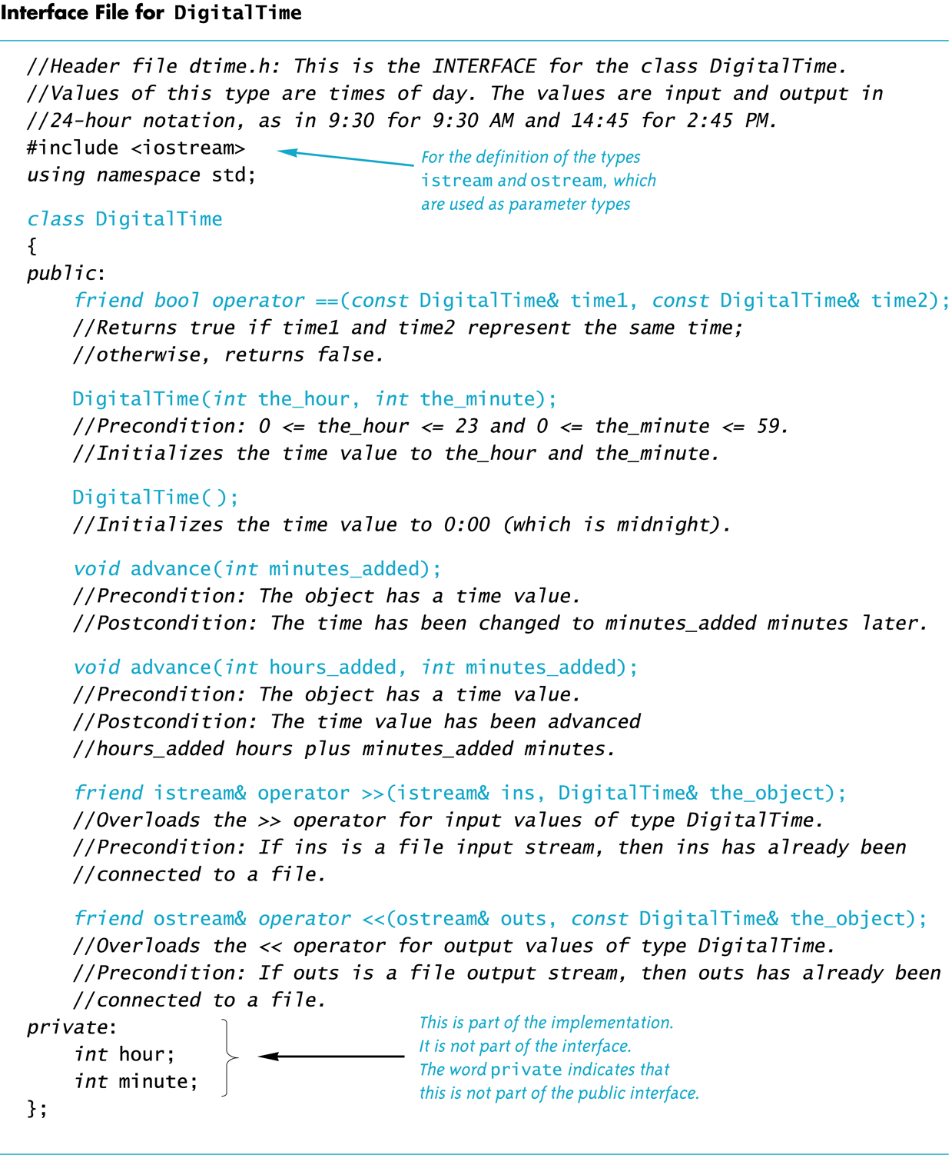
Display 12.1
Back
Next
Slide 12- <number>

Slide 53
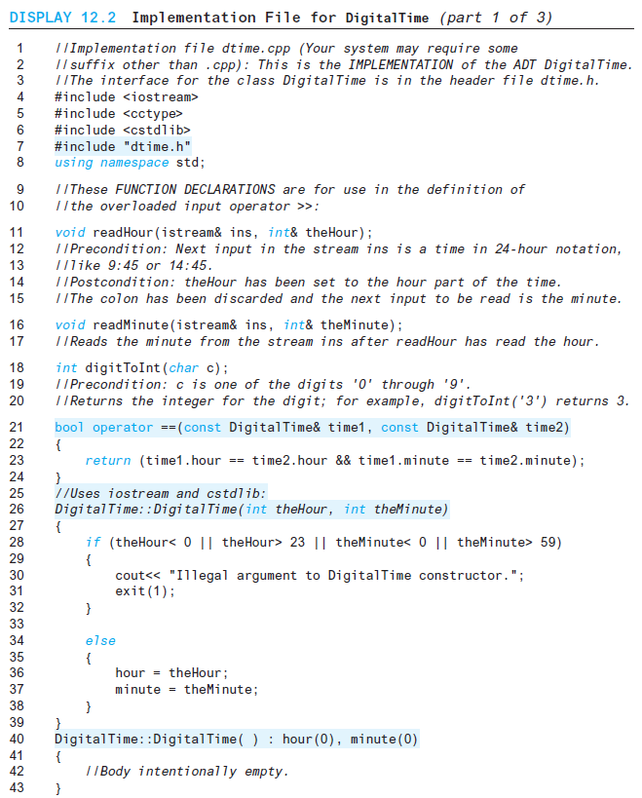
Display 12.2 (1/3)
Back
Next
Slide 12- <number>

Slide 54
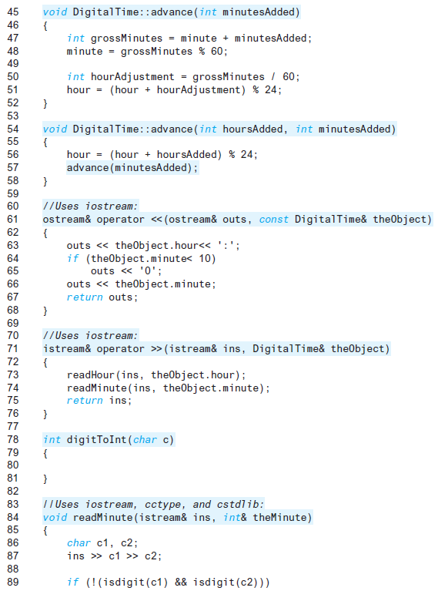
Display 2.2 (2/3)
Back
Next
return ( static_cast<int> ( c ) – static_cast<int>( '0') );
Slide 12- <number>

Slide 55
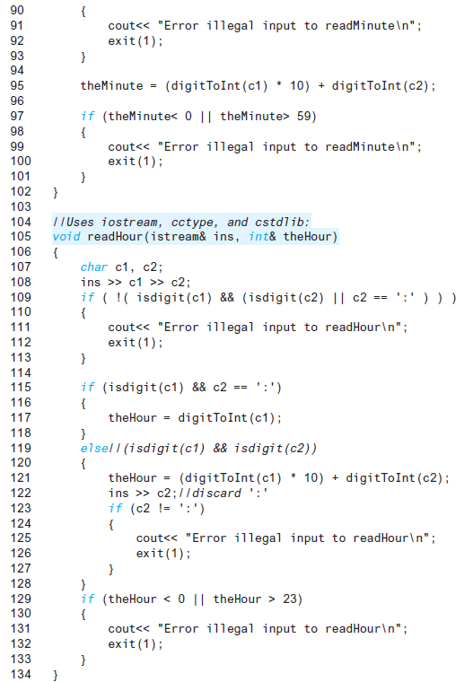
Display 12.2 (3/3)
Back
Next
Slide 12- <number>

Slide 56
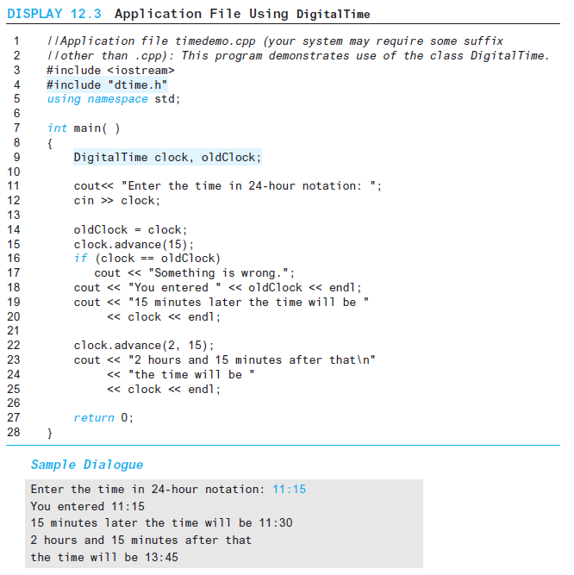
Display 12.3
Back
Next
Slide 12- <number>

Slide 57
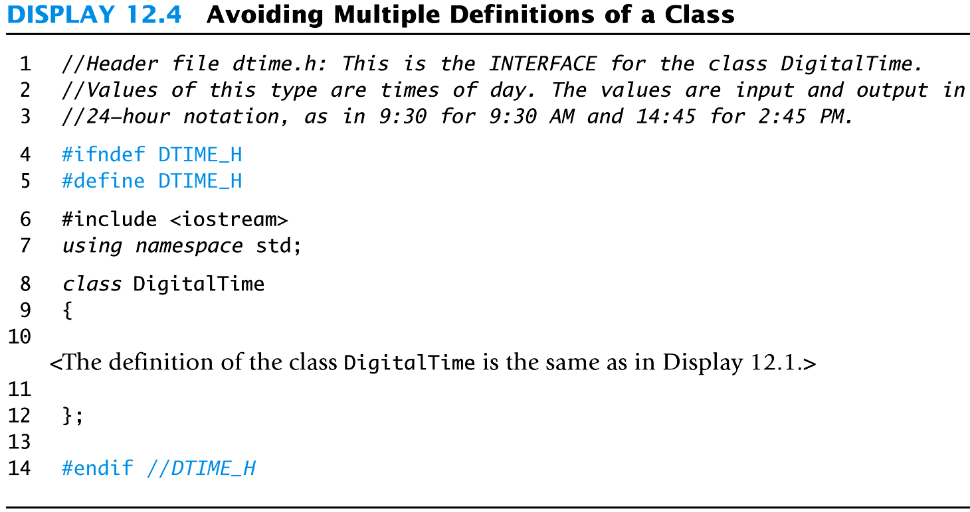
Display 12.4
Back
Next
Slide 12- <number>

Slide 58
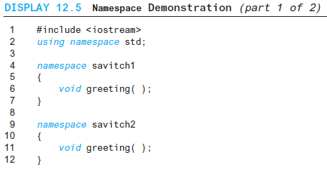
Display 12.5
(1/2)
Back
Next
Slide 12- <number>

Slide 59
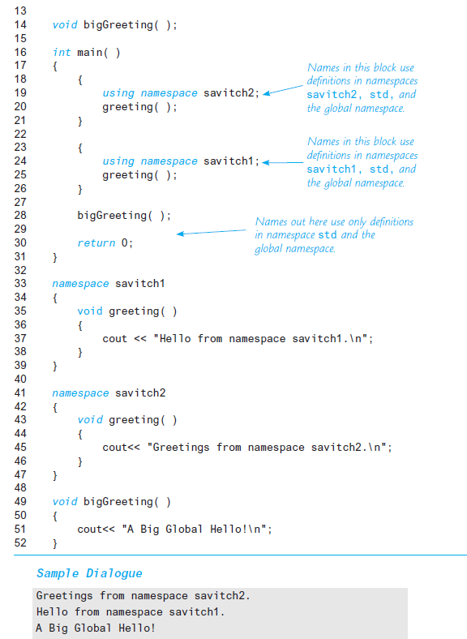
Display 12.5 (2/2)
Back
Next
Slide 12- <number>

Slide 60
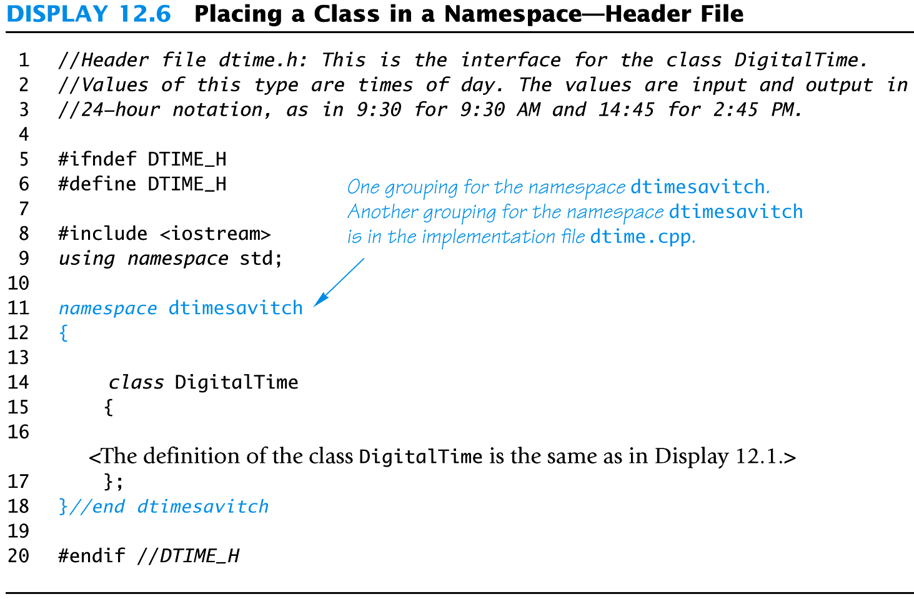
Display 12.6
Back
Next
Slide 12- <number>

Slide 61
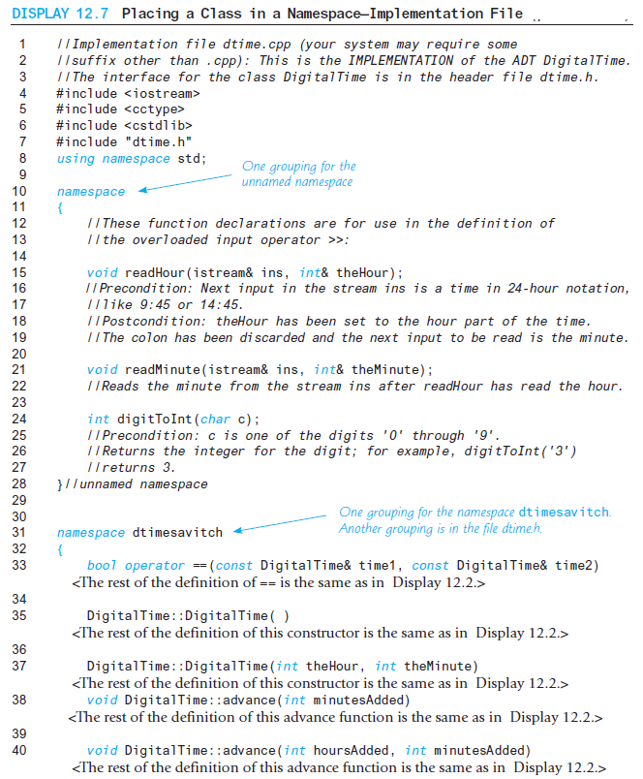
Display 12.7 (1/2)
Back
Next
Slide 12- <number>

Slide 62
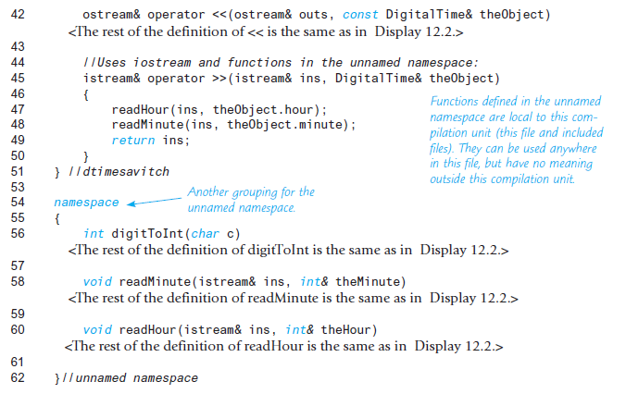
Display 12.7
(2/2)
Back
Next
Slide 12- <number>

Slide 63
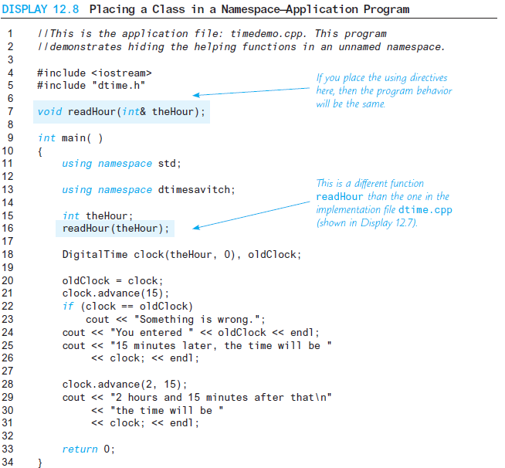
Display 12.8 (1/2)
Back
Next
Slide 12- <number>

Slide 64
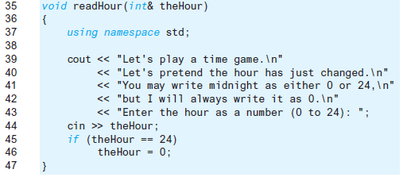
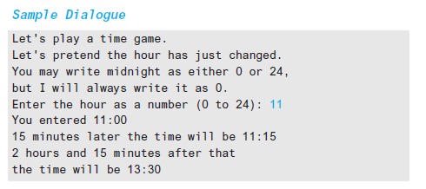
Display 12.8
(2/2)
Back
Next
Slide 12- <number>

